Slide 1
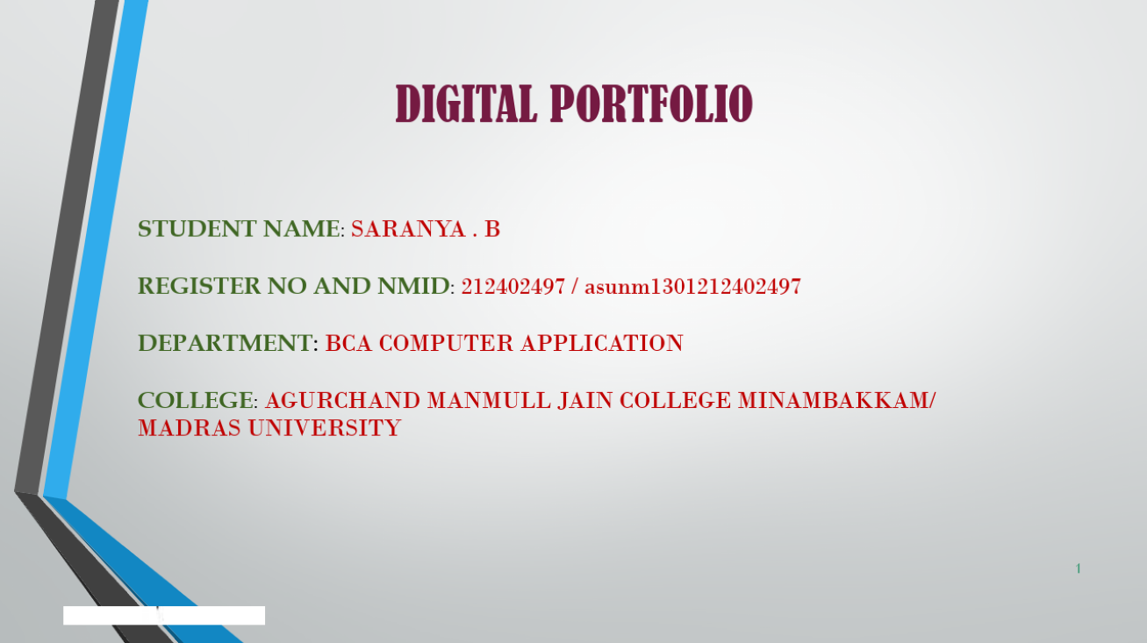

DIGITAL PORTFOLIO
STUDENT NAME: SARANYA . B
REGISTER NO AND NMID: 212402497 / asunm1301212402497
DEPARTMENT: BCA COMPUTER APPLICATION
COLLEGE: AGURCHAND MANMULL JAIN COLLEGE MINAMBAKKAM/
MADRAS UNIVERSITY

Slide 2
DIGITIAL PORTFOLIO:
A digital portfolio is an online or electronic platform that demonstrates an individual’s academic, professional, or creative achievements, allowing others (such as employers, teachers, or clients) to review their skills and accomplishments.

Slide 3
AGENDA:
Problem Statement
Project Overview
End Users
Tools and Technologies
Portfolio design and Layout
Features and Functionality
Results and Screenshots
Conclusion
Github Link
3//2024 Annual Review

Slide 4
PROBLEM STATEMENT:
Traditional resumes cannot fully show a person’s skills and talents. People need a digital portfolio to present their work, projects, and achievements in an easy and attractive way.

Slide 5
PROJECT OVERVIE:
The Digital Portfolio project is designed to create an online platform where individuals can showcase their skills, education, projects, and achievements in a creative and professional way. It helps students and professionals present their talents beyond a traditional resume by including multimedia content such as images, videos, and project links.

Slide 6

Students – to showcase their education, skills, and projectS. Job Seekers / Professionals – to highlight work experience, certifications, and achievements for employers. Teachers / Educators – to assess student skills and track progress. Employers / Recruiters – to evaluate candidates’ abilities before hiring.
WHO ARE THE END USERS:

Slide 7
TOOLS AND TECHNIQUES:
TOOLS:
Website Builders → WordPress, Wix, Google SitesCoding Tools → HTML, CSS, JavaScript, React
Techniques :
Responsive Design → Making the portfolio mobile and desktop friendlyUser-Friendly Navigation → Clear menus and links for easy access

Slide 8
PORTFOLIO DESIGN AND LAYOUT:
DesignTheme & Colors → Use consistent, professional, or pastel tones that match your personality/brand.Typography → Choose clear, readable fonts (e.g., Sans-serif for modern look).Visual Hierarchy → Highlight important sections like About Me, Skills, Projects at the top.

Slide 9
FEATURES AND FUNCTIONALITY:
Features
Skills Section → Lists technical and soft skills.
Projects Showcase → Display completed projects with descriptions, images, or links.
Personal Profile → Includes name, photo, bio, and career objectives.

Slide 10
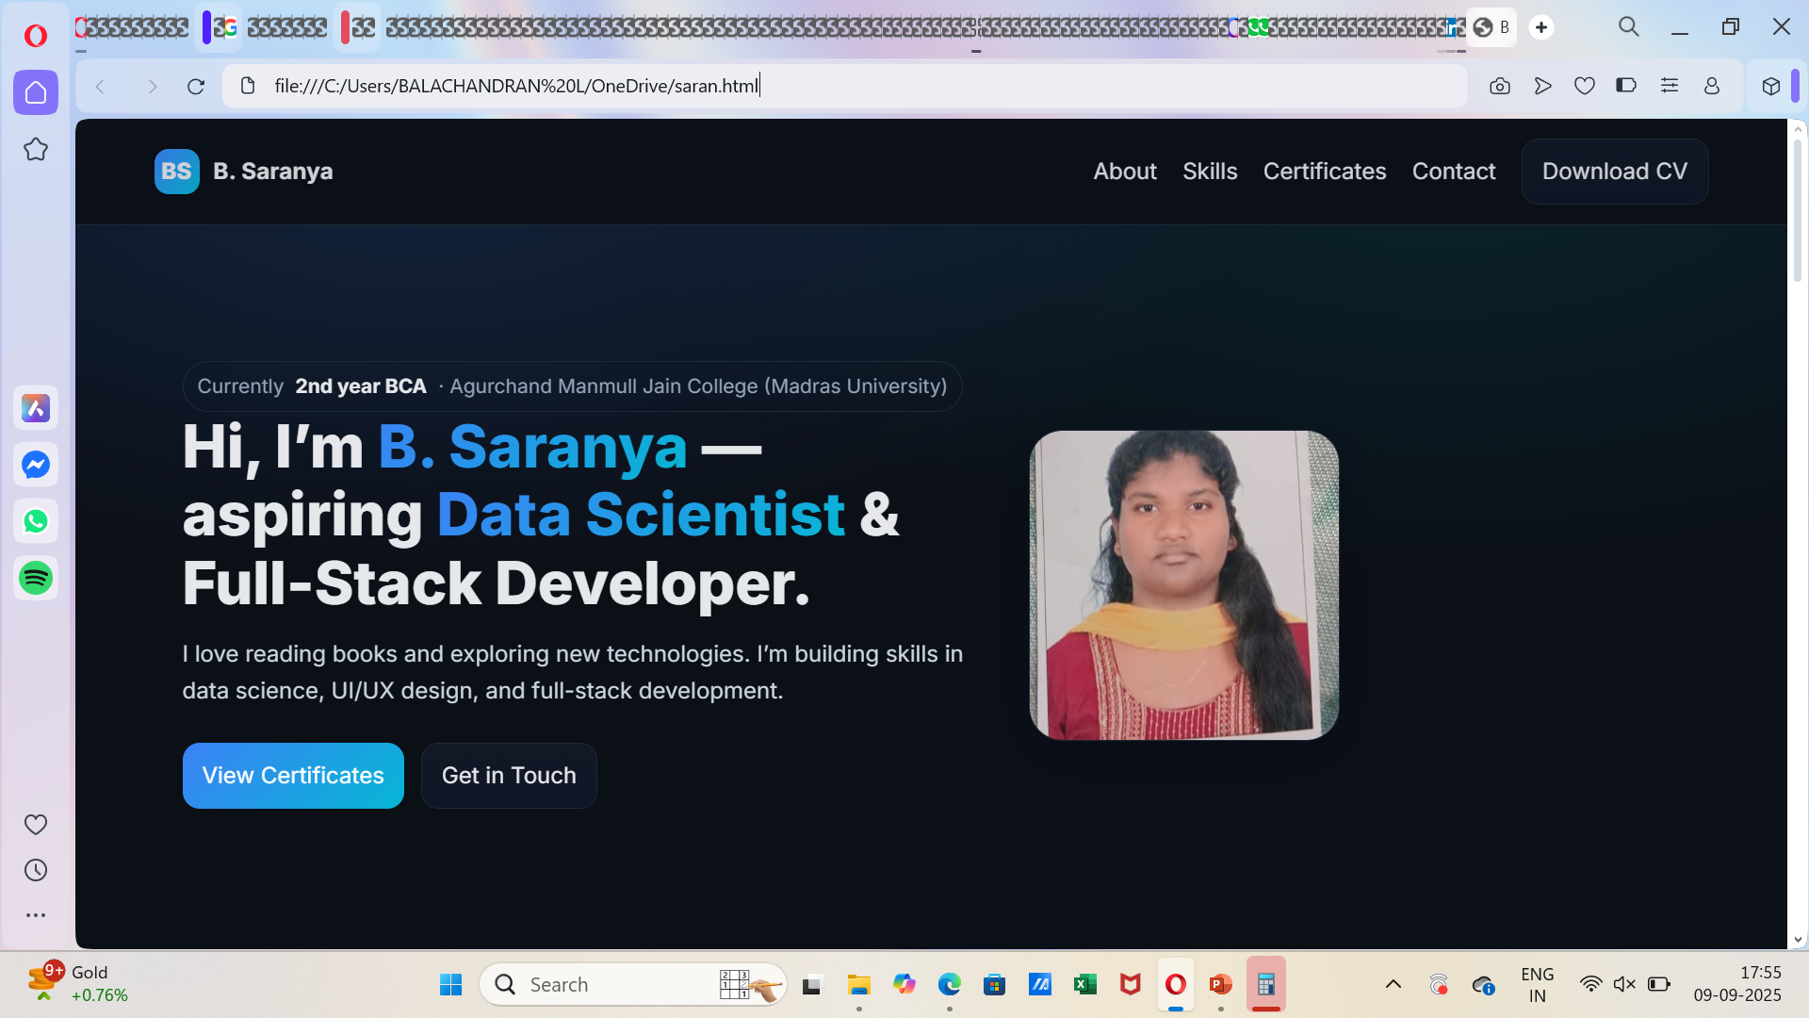
RESULTS AND SCREENSHOTS:
https://saranya772.github.io/protfoilo-3012/
3/21/2024 Annual Review
10

Slide 11
CONCLUSION:
.
A digital portfolio is a powerful tool to showcase one’s skills, achievements, and creativity in an organized way. It helps individuals present their personal and professional growth through projects, certificates, and experiences. Digital portfolios are easy to share, accessible anytime, and provide a modern approach to highlight talents compared to traditional methods. Overall, it acts as a bridge between learning and career opportunities, making it an essential asset for students, professionals, and creative individuals.
11

Slide 12
GITHUB LINK: https://github.com/SARANYA772/protfoilo-3012.git

